Slide 1
Epi 510: Introduction to Stata II

Slide 2
Questions?

Slide 3
Today we're working with the gbdChildMortality.dta dataset:
https://canvas.uw.edu/courses/1580161/files/95696422

Slide 4
set more off
cd "C:/epi510/stata/data"
use "gbdChildMortalityData.dta", clear
compress
Notes:
----- Meeting Notes (9/5/13 16:04) -----
fix mortality

Slide 5
Exploring the dataset

Slide 6
browse view the dataset
help browse

Slide 7
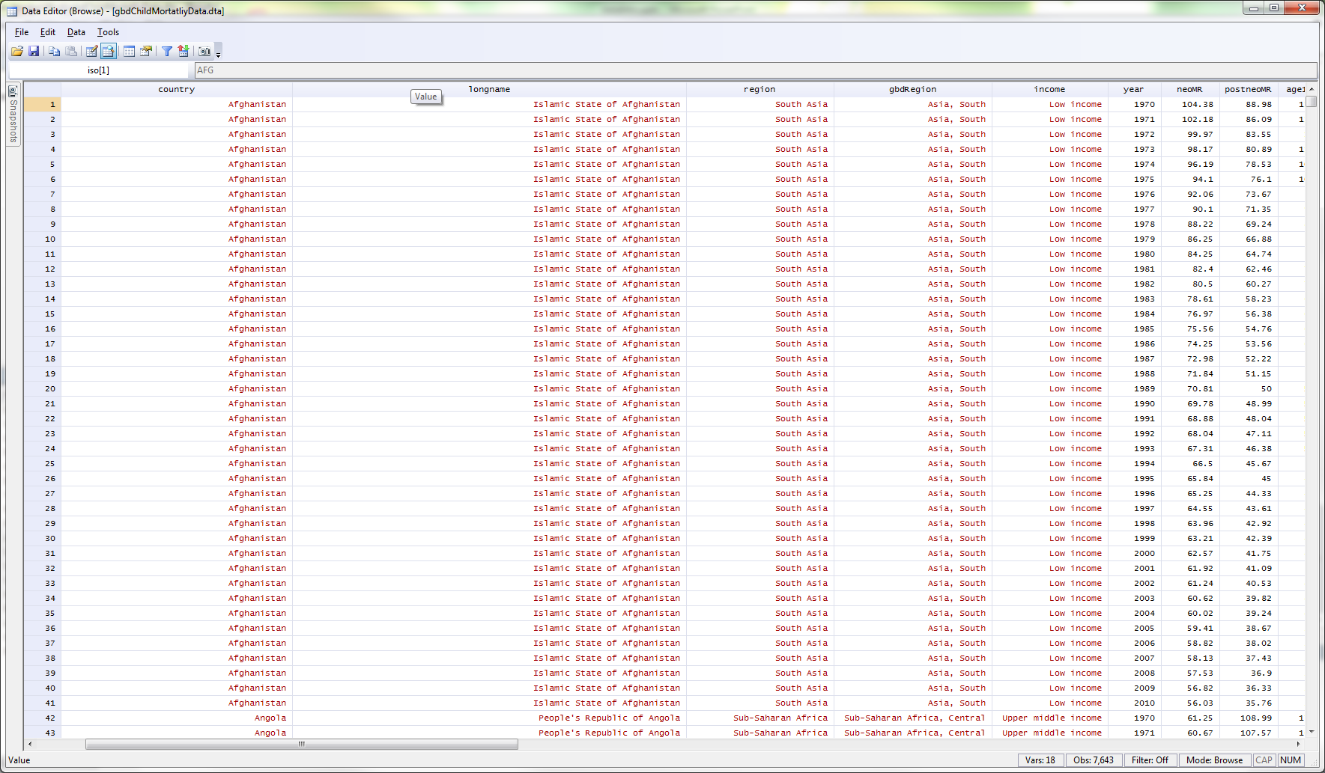
Notes:
String variables = red
Numeric = black

Slide 8
describe returns basic info about each variable in the dataset
help describe

Slide 9
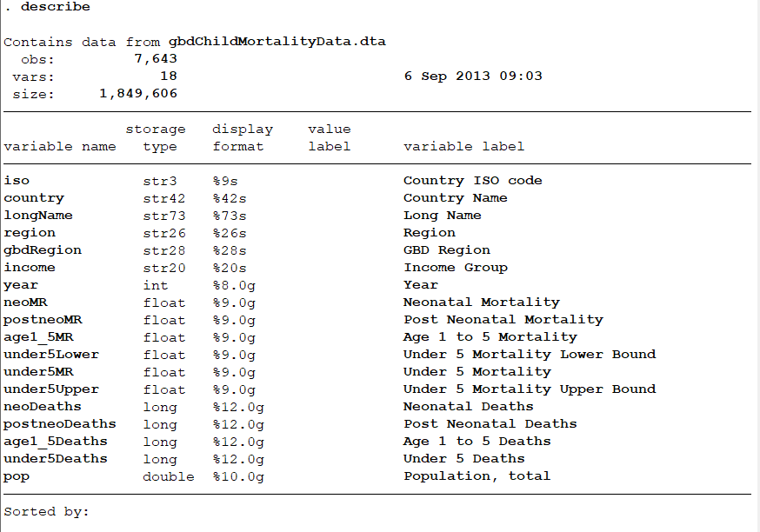
Notes:
Variable label work on plots
Similar to glimpse in r

Slide 10
codebook returns more detailed info about each variable in a codebook format
help codebook
Notes:
Codebook is good for datasets of modest size

Slide 11
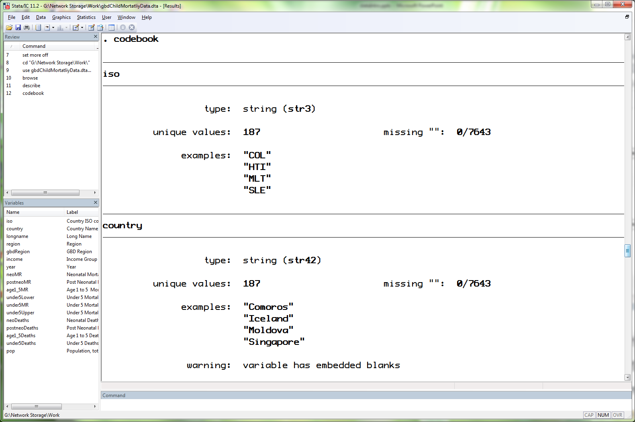
Notes:
Warning: variable has embedded blanks – some spaces are included in value (United States)

Slide 12
Look through the output Compare output for numeric & string vars

Slide 13
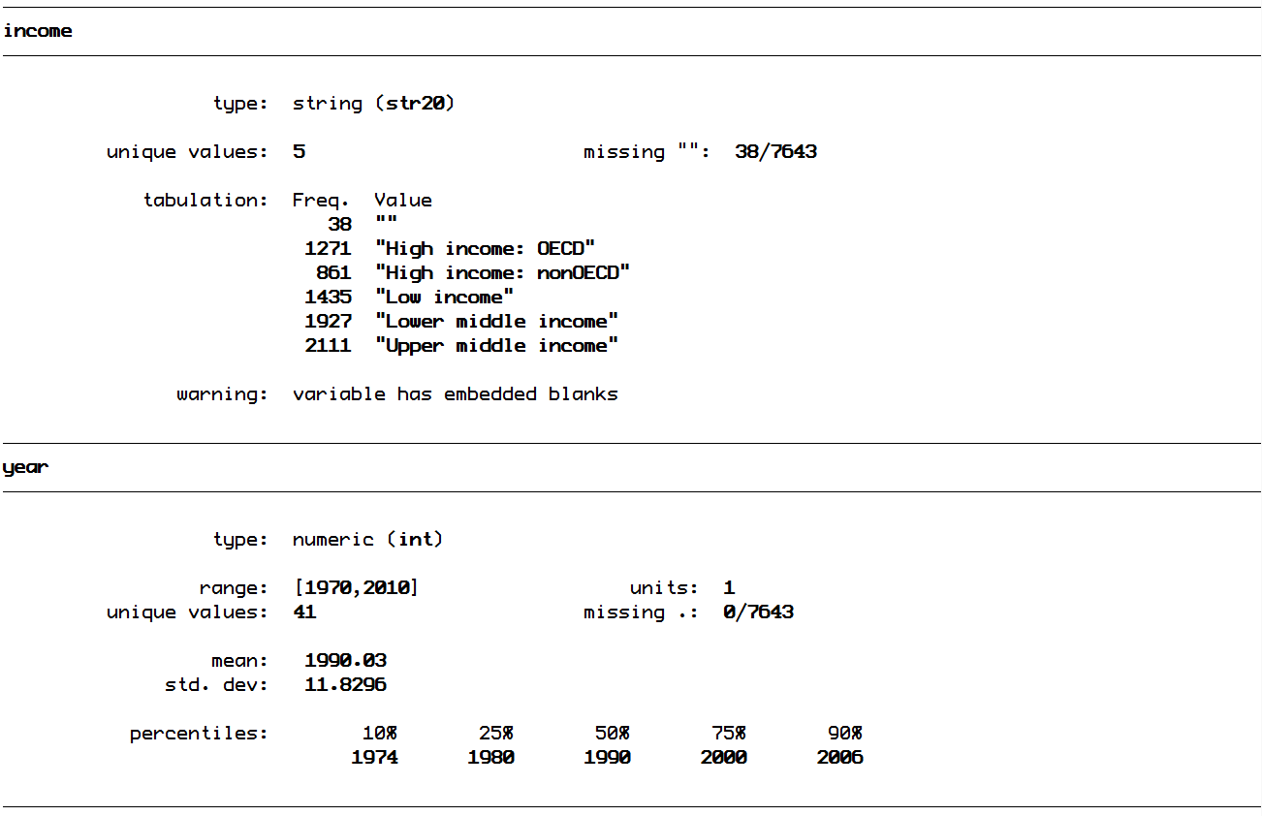

Slide 14
misstable returns a table with information on missingness
help misstable

Slide 15
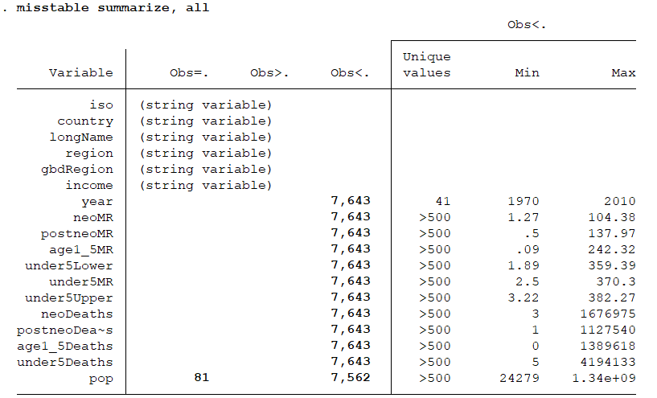
Notes:
Obs>. – picks up .a, .b, etc. missing values
Obs<. – nonmissing values

Slide 16
Specifying variables

Slide 17
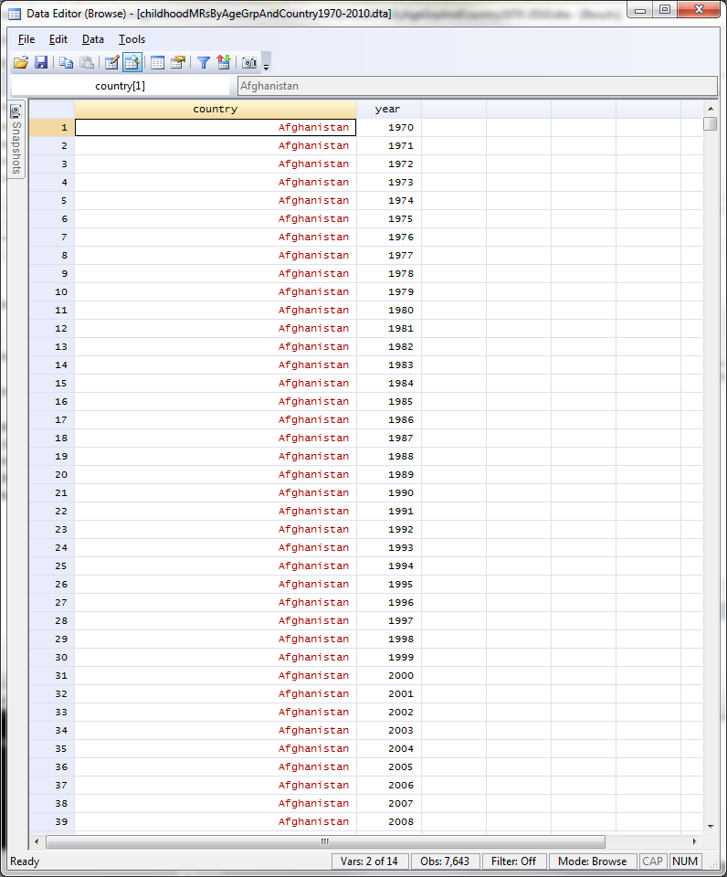
browse country year

Slide 18
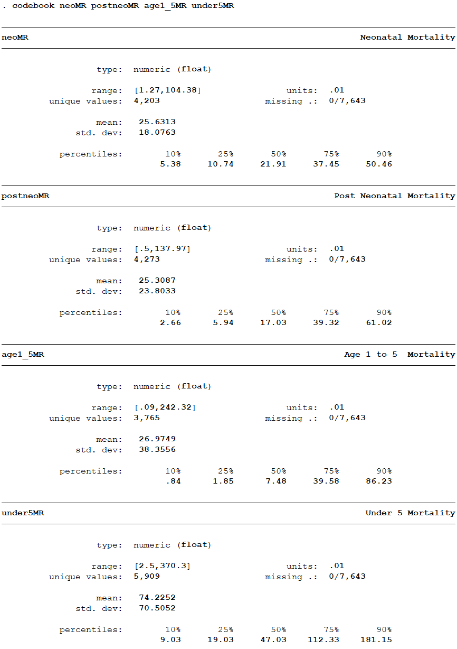
codebook neoMR postneoMR age1_5MR under5MR

Slide 19
Variable list (varlist) notation: shorthand to specify multiple variables

Slide 20
myvar | just one variable
myvar thisvar thatvar | three variables
myvar* | variables starting with ‘myvar’
*var | variables ending with ‘var’
my*var | variables starting with ‘my’ & ending with ‘var’ with any number of other characters between
my?var | variables starting with ‘my’ & ending with ‘var’ with one other character between
this-that | variables ‘this’ through ‘that’, inclusive
help varlist
Notes:
Myvar thisvar that var – three variables
Myvar* variables starting with myvra
*var variables ending with ‘var’
My*var variables starting with my & ending with ‘var’ with any number of characters inbetween
My?var – variables starting with ‘my’ and ending with ‘var’ with one other character inbetween
This-that – variables this through that, inclusive (good if variables are ordered how you want them to be)

Slide 21
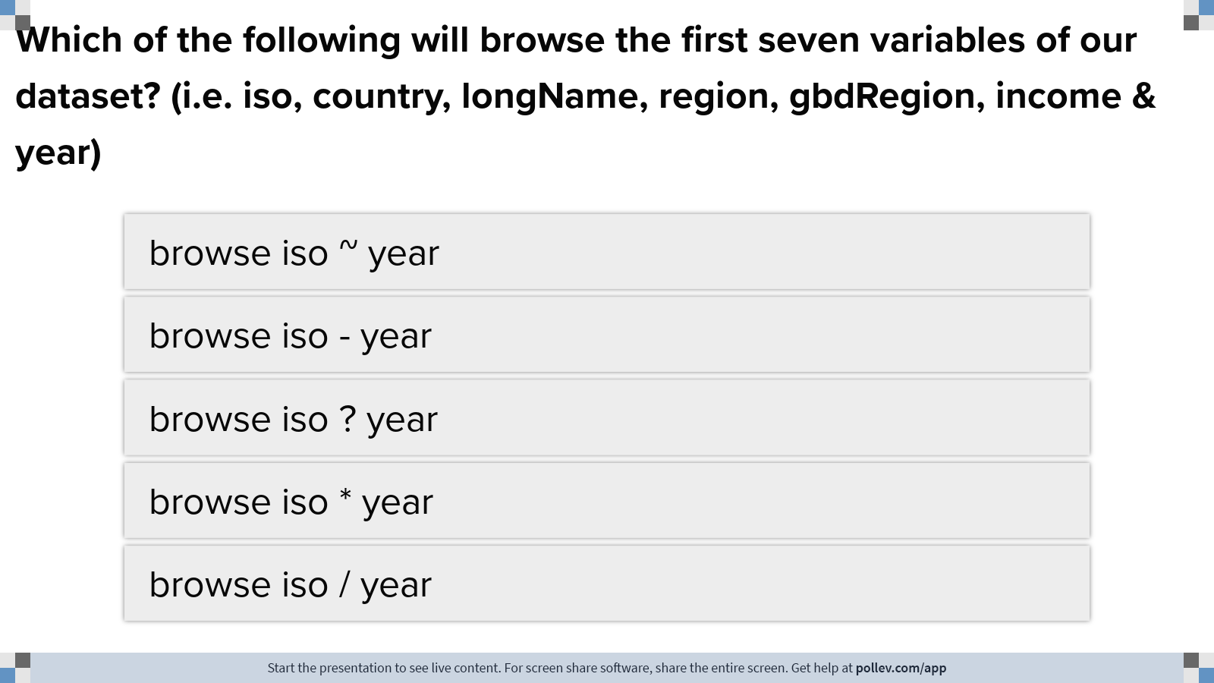
Notes:
Poll Title: Which of the following will browse the first seven variables of our dataset? (i.e. iso, country, longName, region, gbdRegion, income & year) https://www.polleverywhere.com/multiple_choice_polls/NwavYzI4jSs9AJDS4YgzW?display_state=instructions&activity_state=opened&state=opened&flow=Engagement&onscreen=persist

Slide 22
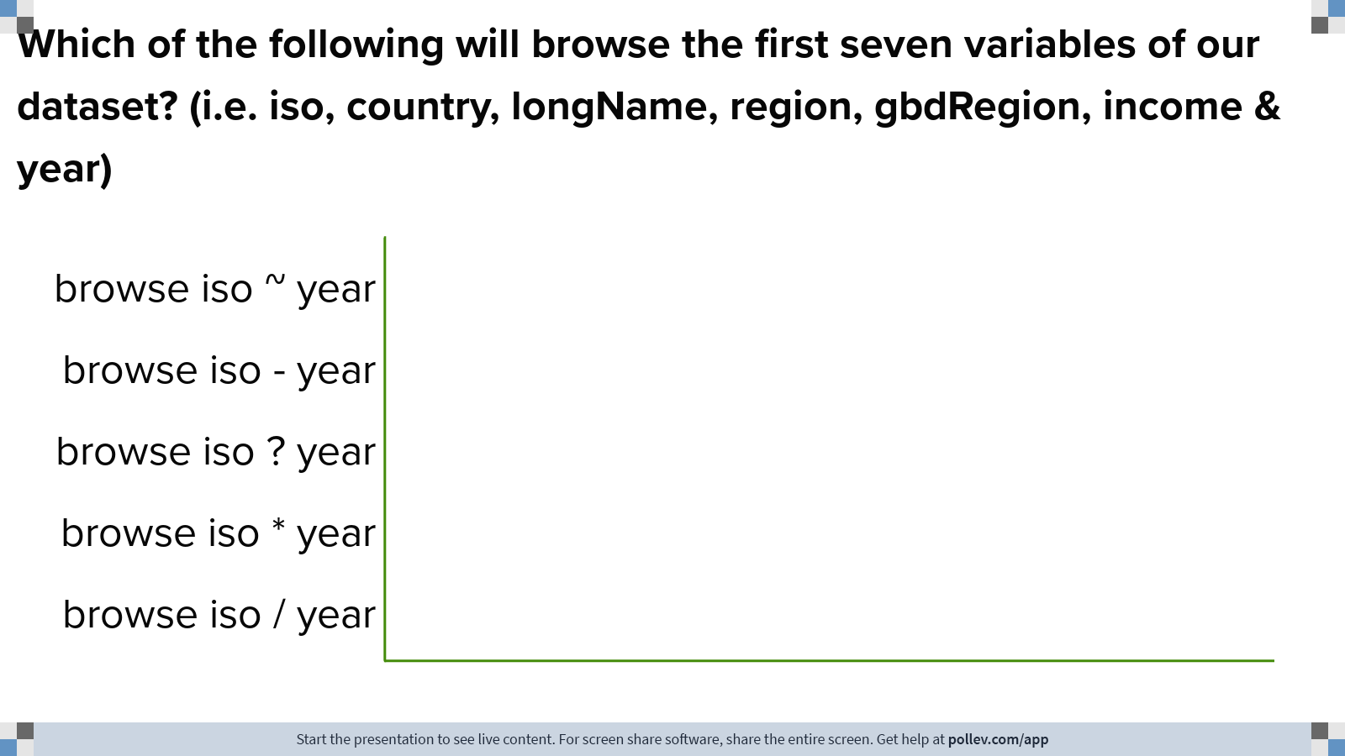
Notes:
Poll Title: Which of the following will browse the first seven variables of our dataset? (i.e. iso, country, longName, region, gbdRegion, income & year) https://www.polleverywhere.com/multiple_choice_polls/NwavYzI4jSs9AJDS4YgzW?display_state=chart&activity_state=opened&state=opened&flow=Engagement&onscreen=persist

Slide 23
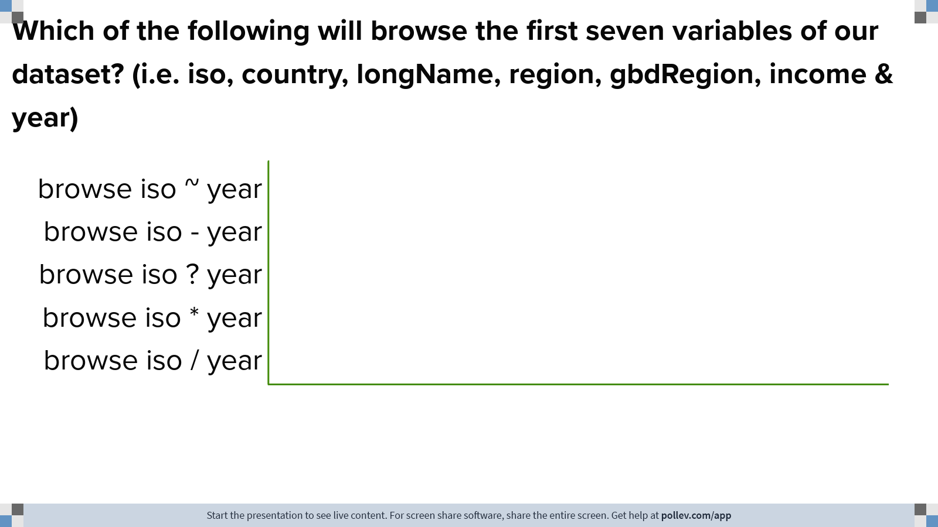
Notes:
Poll Title: Which of the following will browse the first seven variables of our dataset? (i.e. iso, country, longName, region, gbdRegion, income & year) https://www.polleverywhere.com/multiple_choice_polls/NwavYzI4jSs9AJDS4YgzW?display_state=chart&activity_state=closed&state=closed&flow=Engagement&onscreen=persist

Slide 24
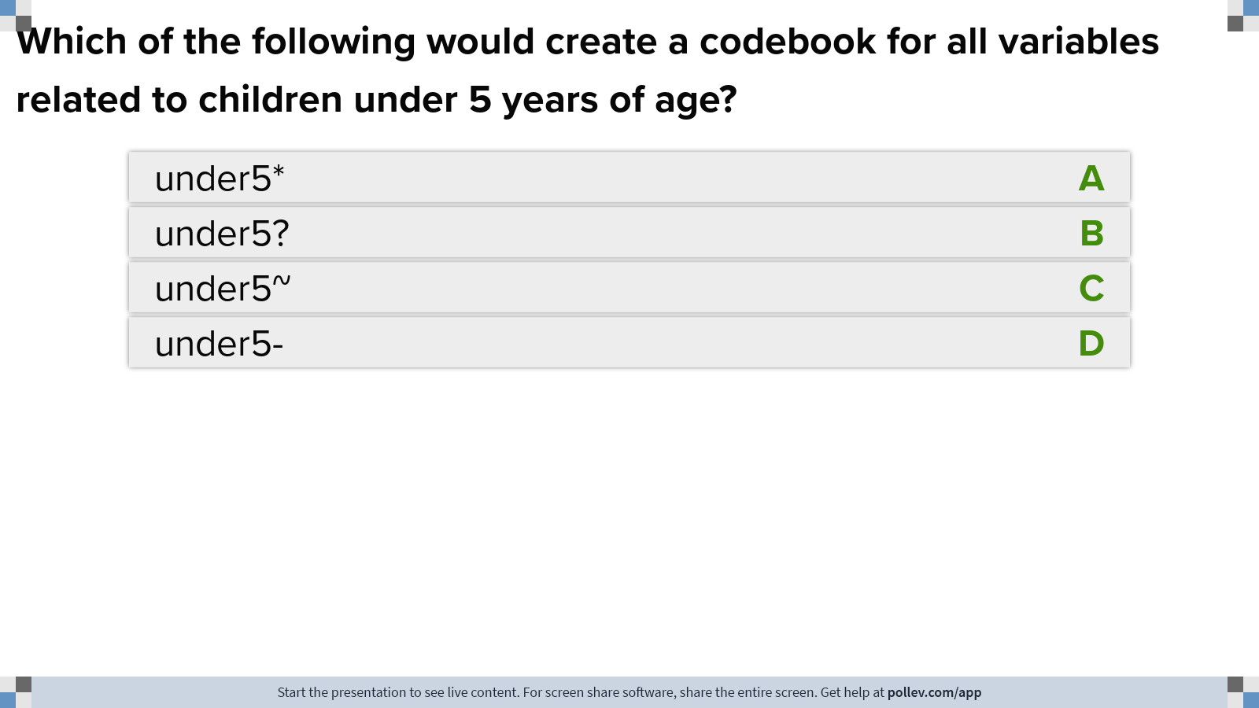
Notes:
Poll Title: Which of the following would create a codebook for all variables related to children under 5 years of age? https://www.polleverywhere.com/multiple_choice_polls/Am3YNlpFffYBqYaKavCaw?display_state=instructions&activity_state=opened&state=opened&flow=Engagement&onscreen=persist

Slide 25
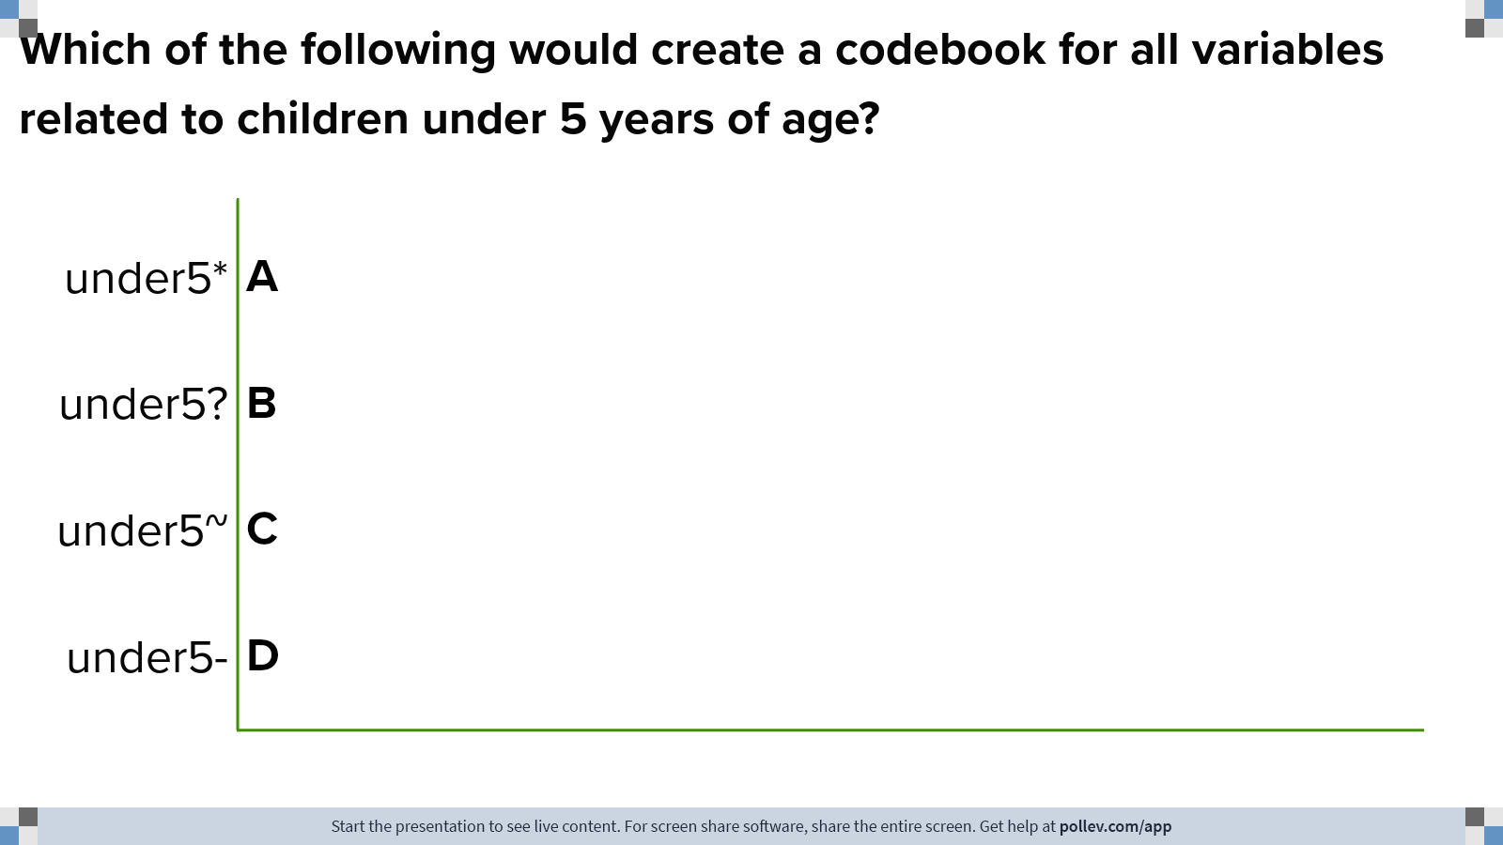
Notes:
Poll Title: Which of the following would create a codebook for all variables related to children under 5 years of age? https://www.polleverywhere.com/multiple_choice_polls/Am3YNlpFffYBqYaKavCaw?display_state=chart&activity_state=opened&state=opened&flow=Engagement&onscreen=persist

Slide 26
Notes:
Poll Title: Which of the following would create a codebook for all variables related to children under 5 years of age? https://www.polleverywhere.com/multiple_choice_polls/Am3YNlpFffYBqYaKavCaw?display_state=chart&activity_state=closed&state=closed&flow=Engagement&onscreen=persist

Slide 27
Summary statistics

Slide 28
summarize returns a table of summary stats
help summarize

Slide 29
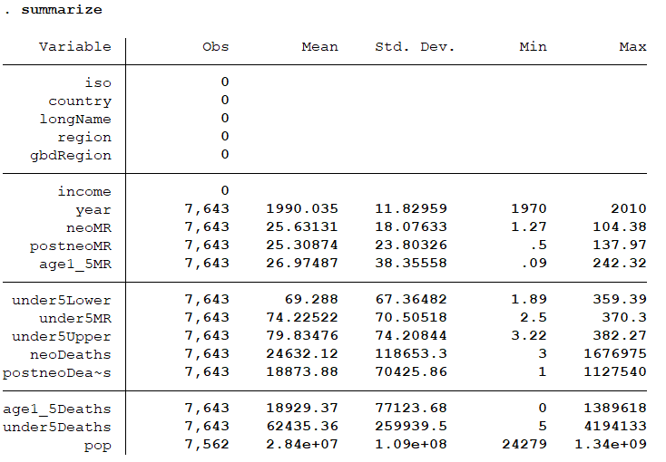
help summarize

Slide 30
Exercise:
Summarize variables neoMR through under5Deaths
summarize neoMR - under5Deaths
help summarize

Slide 31
help summarize

Slide 32
Now try summarize neoMR - under5Deaths, detail
help summarize

Slide 34
Frequency tables

Slide 35
tabulate creates one- & two-way frequency tables
help tabulate

Slide 36
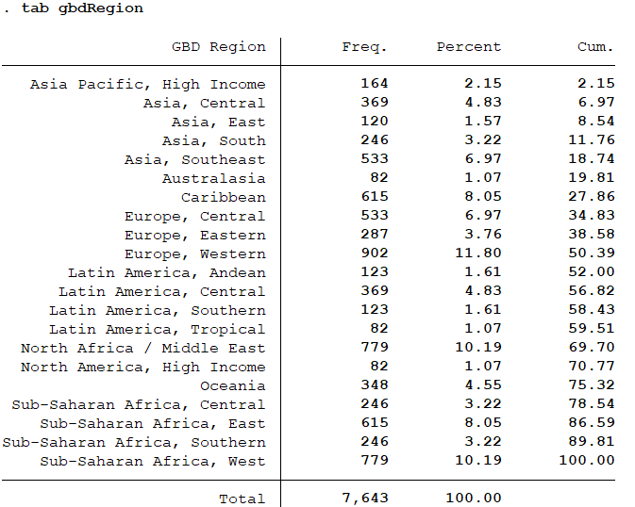
tabulate gbdRegion

Slide 37
Exercise

Slide 38
Create separate frequency tables for region & income
help tabulate
Notes:
Tab one income region shortcut for indivudal tables

Slide 41
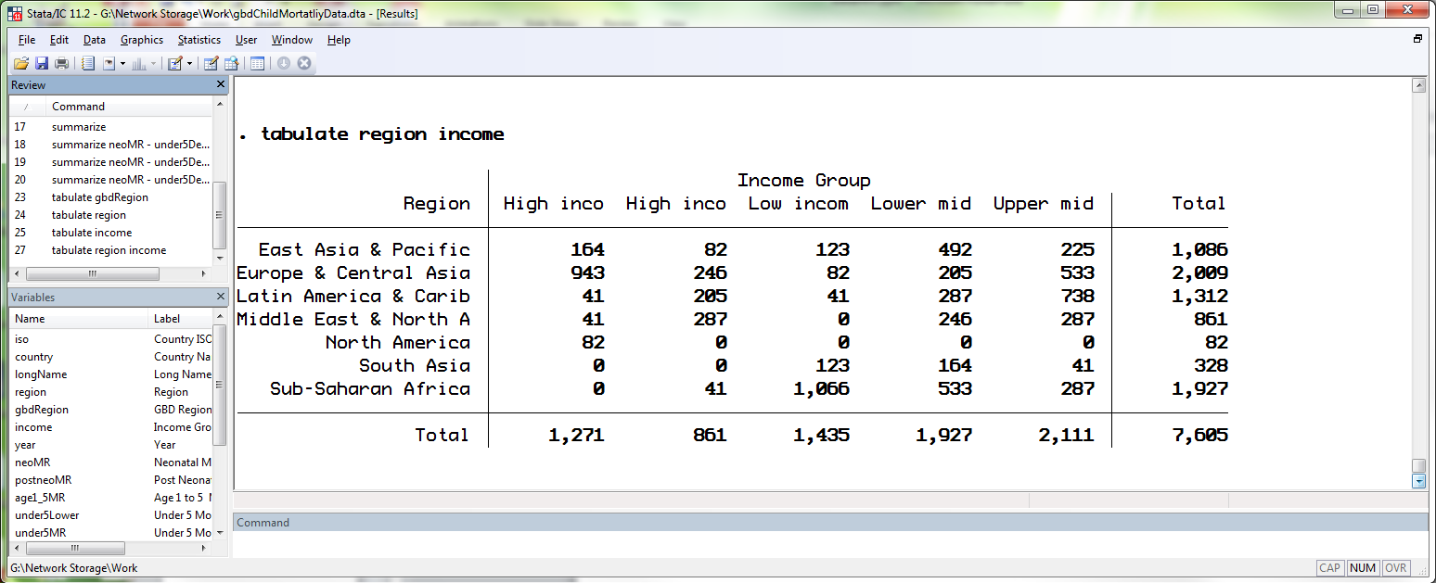
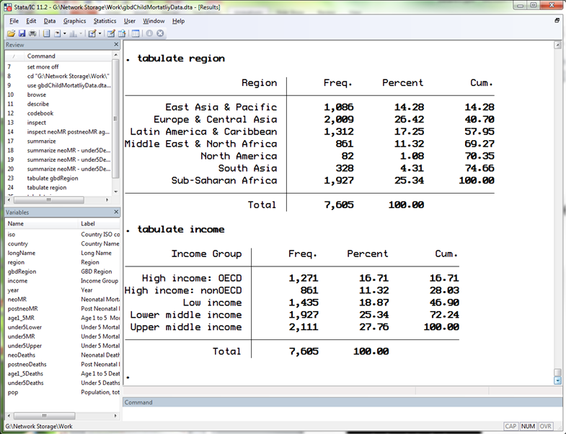
one-way
two-way

Slide 42
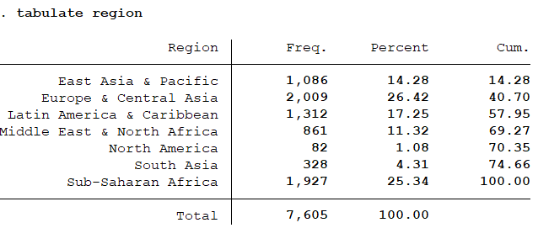
See a disparity?
Notes:
Different totals – by default, it doesn’t show missing values

Slide 44
Try…
tabulate gbdRegion, missing
tabulate region, missing
tabulate income, missing
tabulate region income, missing
help tabulate
Notes:
“, m” – shortcut for ", missing”

Slide 45
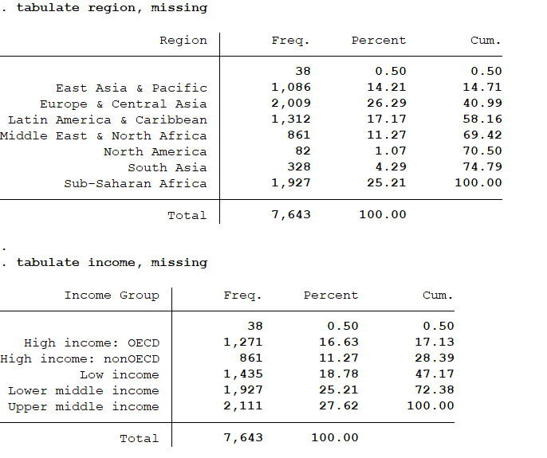

Slide 46
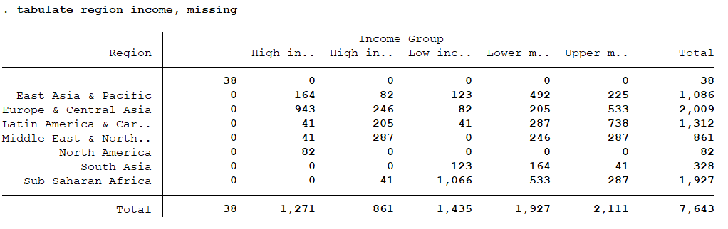

Slide 47
Tables of summary statistics

Slide 48
tabstat returns a compact table of summary stats
help tabstat

Slide 49
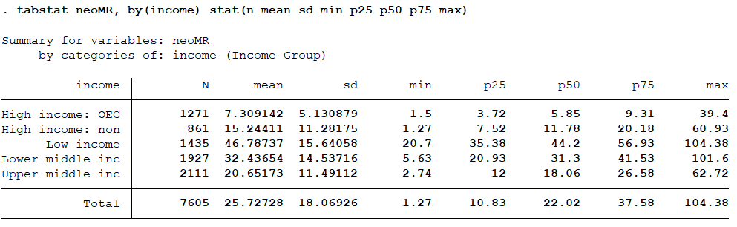
help summarize
Notes:
Summarize neoMR, by income
Stat option (default is just to give mean neoMR in each income category)
Can specify what stats you want it to return

Slide 50
Restricting observations

Slide 51
3
broad approaches:
include only observations having specified values of a variable(s)
include only those observations in specified rows
repeat the operation for each value of a specified variable

Slide 52
3
broad approaches:
if
in
by

Slide 53
if at the end of a command means the command is to use only the data specified
command if exp
where exp indicates a logical expression (e.g. age>21)
help if

Slide 54
Relational operators
> | greater than
< | less than
>= | > or equal
<= | < or equal
== | equal*
!= | not equal
~= | not equal
*
double equal-sign used for equality testing
help operator

Slide 55
Logical operators
& | and
| | or
! | not
~ | not
Can use parentheses to indicate evaluation order
help operator

Slide 56
summarize neoMR if year==1980 summarize neoMR if year>=2000 summarize neoMR if year>=1990 & year<=1999
help if

Slide 57
What about string variables?

Slide 58
summarize neoMR if country=="Afghanistan" summarize under5MR if region=="South Asia" | region=="East Asia & Pacific"
help if

Slide 59
3
broad approaches:
if
in
by

Slide 60
in at the end of a command means the command is to use only the observations specified
command in range
where range is
#
#/#
help in

Slide 61
browse in 1/20
help in

Slide 62
3
broad approaches:
if
in
by

Slide 63
Creating variables

Slide 64
generate creates a new variable
help generate

Slide 65
generate x = 1
generate one = "one"
generate highIncome = 1 if ///
income=="High income: nonOECD" | ///
income=="High income: OECD"
df$highIncome[df$income=="High income: nonOECD" |
df$income=="High income: OECD"] <- 1
help generate
Notes:
/// = continue reading code on next line

Slide 66
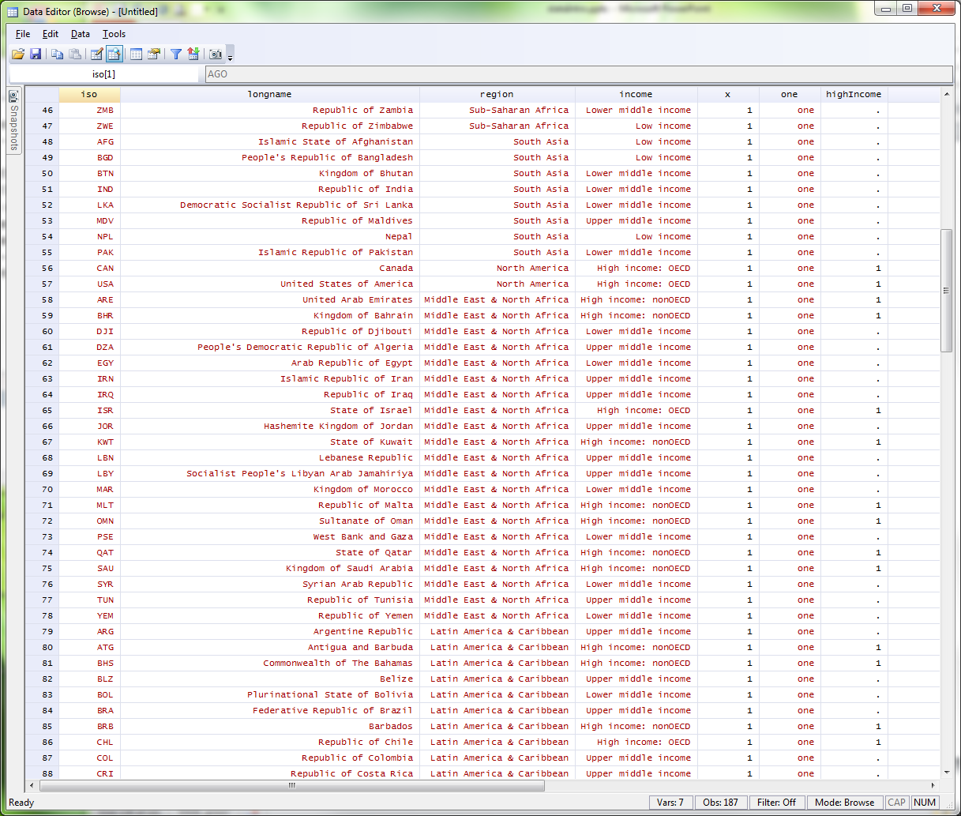

Slide 67
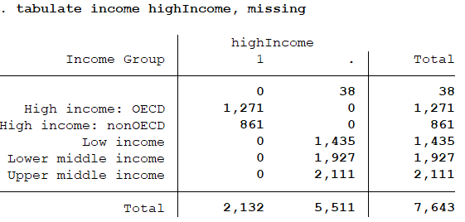
Notes:
Check what you’ve done so far

Slide 68
replace change contents of an existing variable
help replace

Slide 69
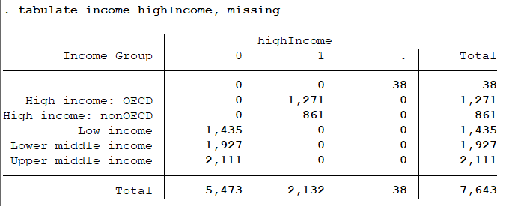
replace highIncome = 0 if highIncome == . & income != ""
replace highIncome = 0 if missing(highIncome) & !missing(income)
Notes:
“” – equivalent of missing for a string in stata
! = not

Slide 70
Variable names

Slide 71
Variable names in Stata
1 to 32 characters long
Must start with letter or underscores
Remaining characters may be letters, numbers or underscores
Case sensitive
help varname

Slide 72
&
snake_case
camelCase

Slide 73
vs
typeability
readability

Slide 74
typeable, not readable
reasonable balance
readable, not typeable
>
>
>
p pop totalNationalPopulation

Slide 75
Be consistent & systematic!

Slide 76
Command syntax

Slide 77
command [varlist] [=exp][if exp][in range] [weight][, options]
= exp
set something equal to something else; for example, generate newvar = 2; may or may not be optional
in range
optionally restrict command to specified observations
varlist:
optionally specify the variables to which you’d like the command applied
command
what you want Stata to do (e.g. summarize, tabulate, browse)
if exp
optionally restrict command to the specified data
, options
optionally specify any command options (e.g. tabulate country, missing)
weight
optionally weight observations by some factor – more to come
Notes:
Command you want to run [optionally you have a varlist you want to specify or the variable you’d like to generate] [generate or replace command = x]
If statements go before comma, they aren’t considered options

Slide 78
Exercise

Slide 79
Load worldBankCountryIndicators.dta
Explore dataset
Create two GDP per capita varables:
GDP per capita in constant 2005 US$ (i.e. gdp2005/pop)
GDP per capita in current US$ (i.e. gdpCurrent/pop)
Create a binary variable indicating nearly complete (at least 99%) primary school enrollment.
“0” if enrollAll is < 99;
“1” if enrollAll is ≥ 99;
“.” if enrollAll is missing
Notes:
Generate schoolencomp = enrollAll>=99 if !missing(enrollAll)

Slide 82
Two more ways to explore your data: list & count

Slide 83
list lists values of variables
help list

Slide 84
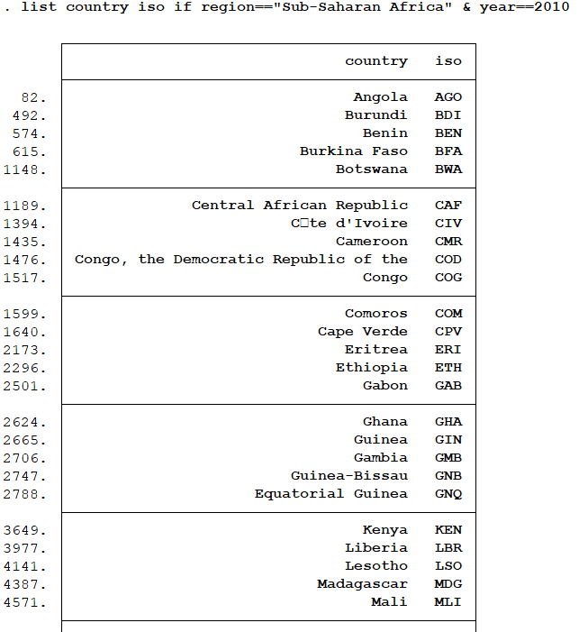
list country iso if ///
region=="Sub-Saharan Africa" ///
& year==2010

Slide 85
count count observations satisfying specified conditions
help count

Slide 86
count if region=="Sub-Saharan Africa" & year==2010

Slide 87
Questions?

